Slide 1
Lecture 6: Multiple and Poly Linear Regression

Slide 2
ANNOUNCEMENTS
Office Hours:
More office hours, schedule will be posted soon.
On-line office hours are for everyone, please take advantage of them.
Projects:
Project guidelines and project descriptions will be posted Thursday 9/25.
Milestone-1: Signup for project is Wed 10/2 .

Slide 3
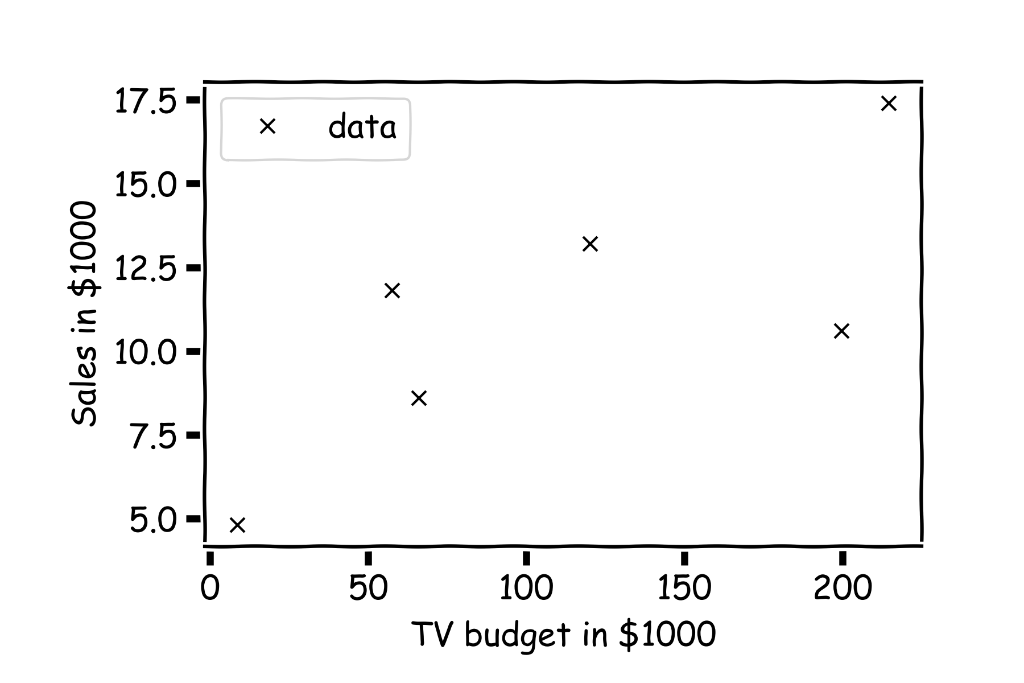
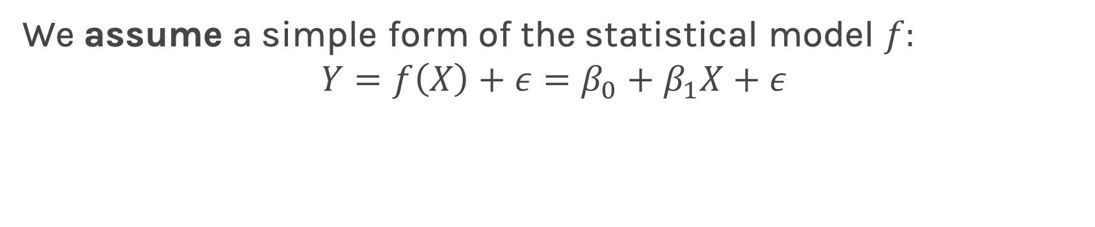
Summary from last lecture
We assume a simple form of the statistical model $f:$
$$Y=f\left(X\right)+ε=β_{0}+β_{1}X+ε$$

Slide 4
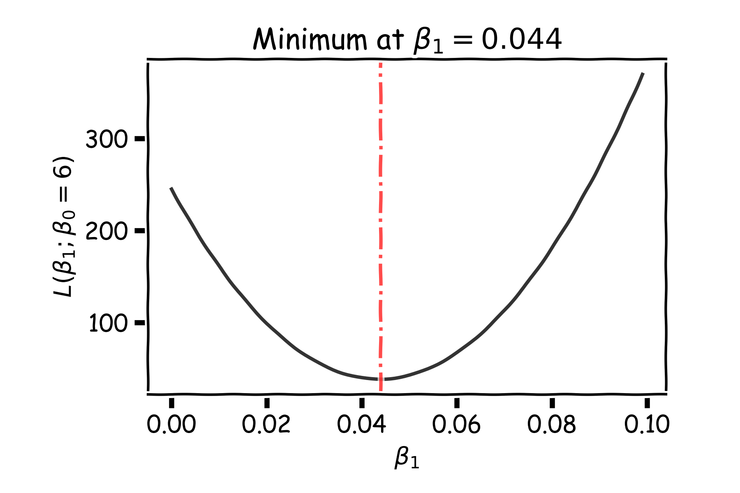
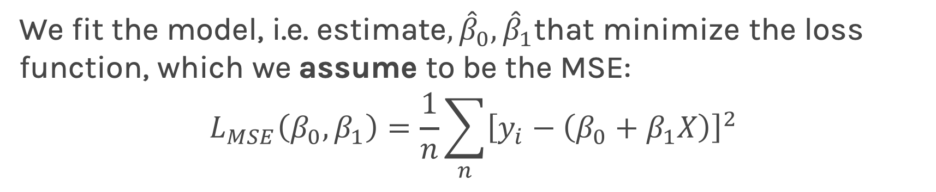
Summary from last lecture
We fit the model, i.e. estimate$, {\hat{β}}_{0},{\hat{β}}_{1}$that minimize the loss function, which we assume to be the MSE:
$$L_{MSE}\left(β_{0}, β_{1}\right)=\frac{1}{n}\sum_{n}{{\left[y_{i}−\left(β_{0}+β_{1}X\right)\right]}^{2}}$$

Slide 5
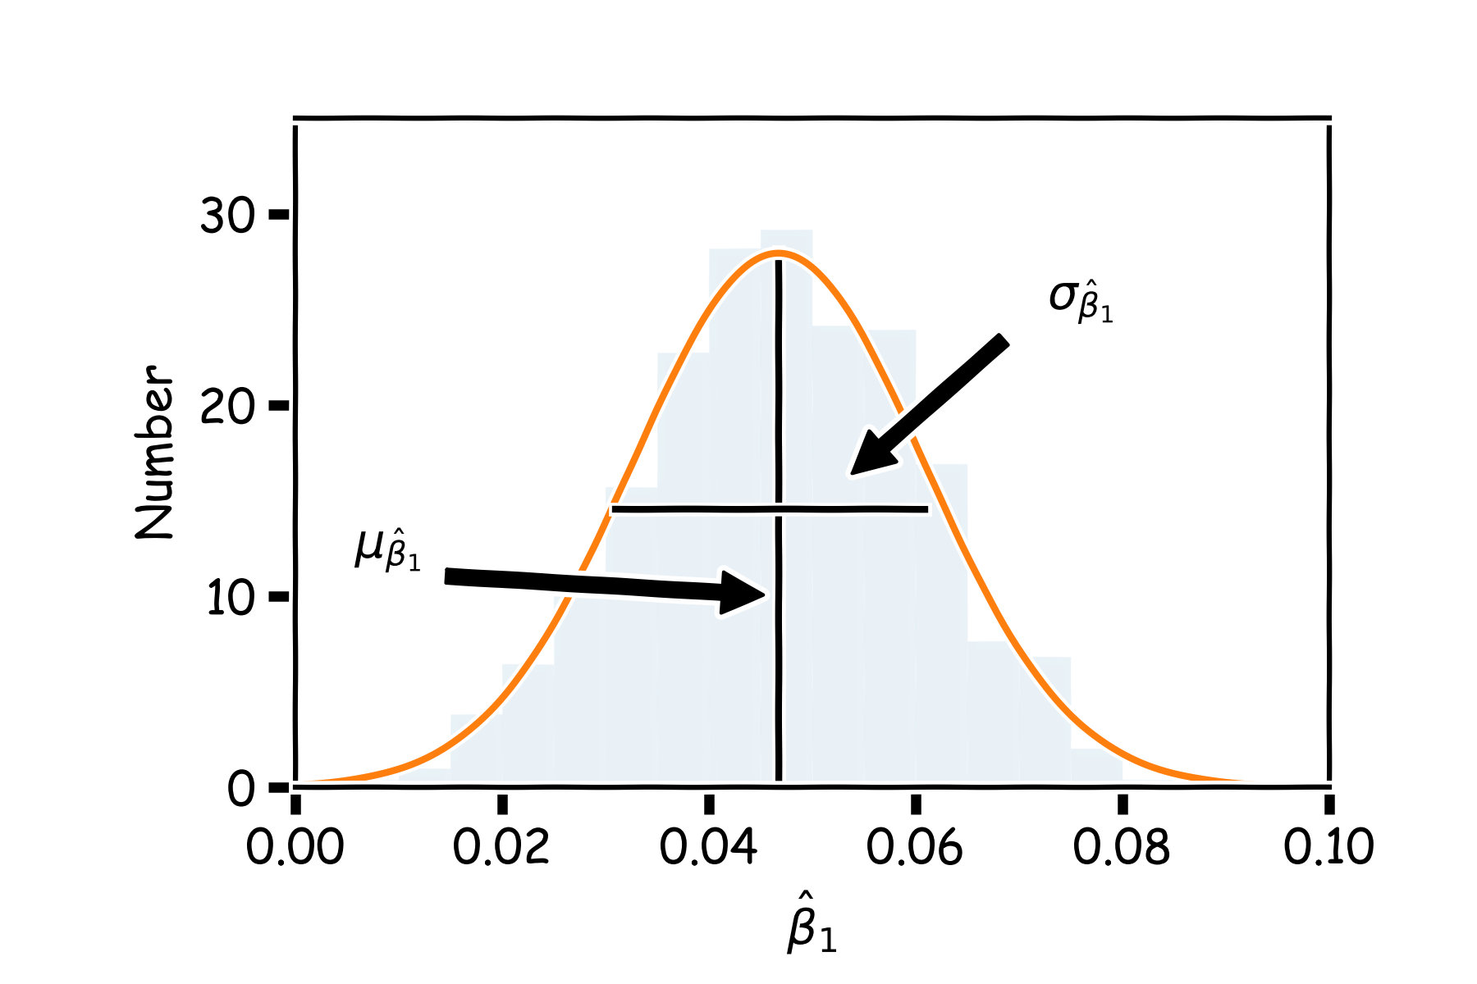
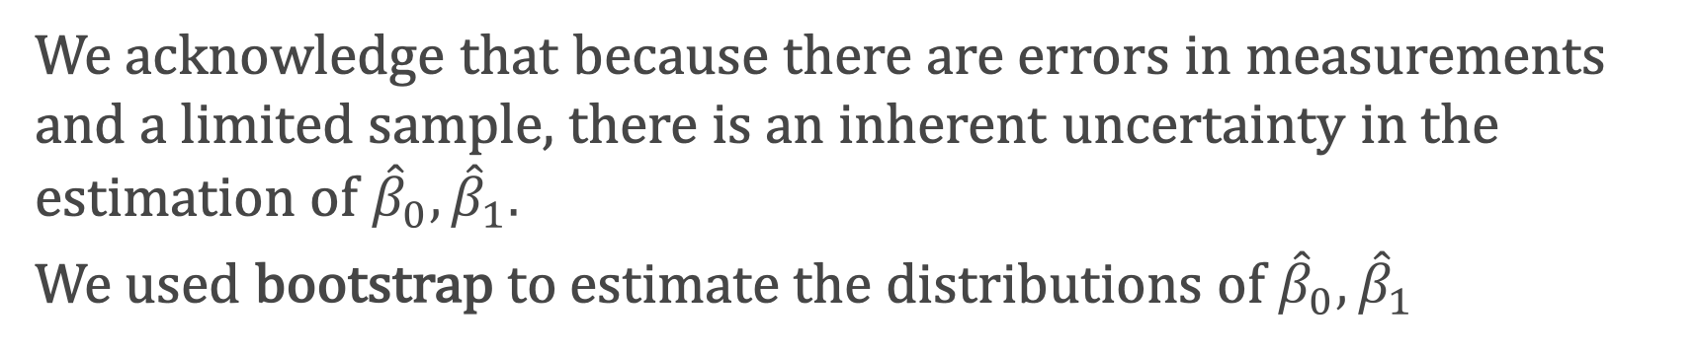
Summary from last lecture
We acknowledge that because there are errors in measurements and a limited sample, there is an inherent uncertainty in the estimation of ${\hat{β}}_{0},{\hat{β}}_{1}.$
We used bootstrap to estimate the distributions of ${\hat{β}}_{0},{\hat{β}}_{1}$
2

Slide 6
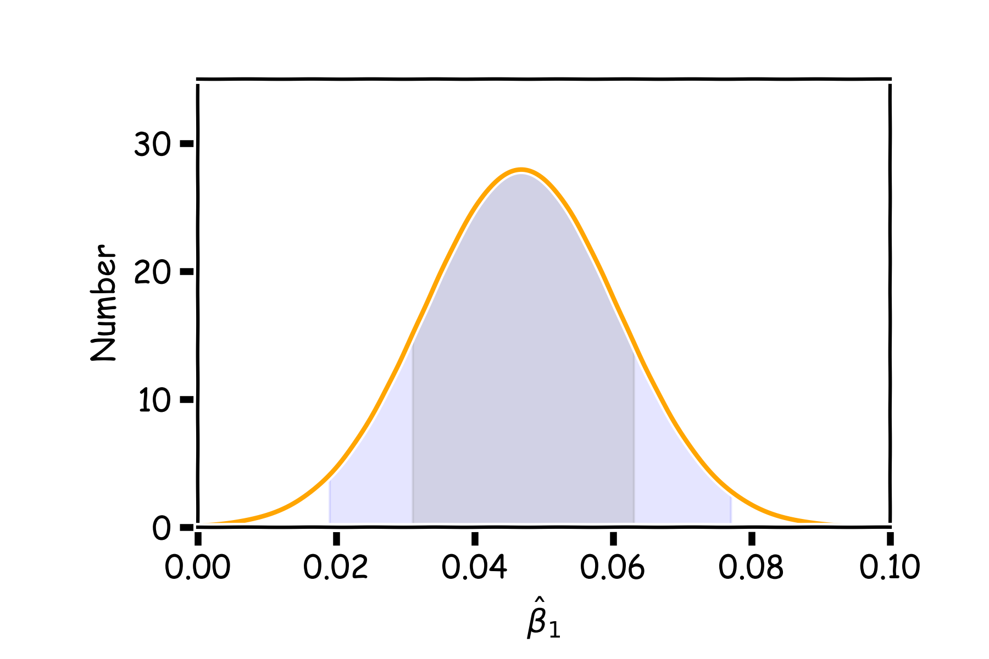
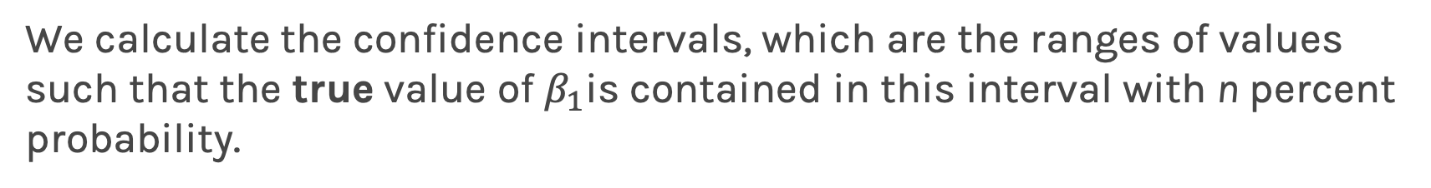
Summary from last lecture
We calculate the confidence intervals, which are the ranges of values such that the true value of $β_{1}$is contained in this interval with n percent probability.
95%
68%

Slide 7
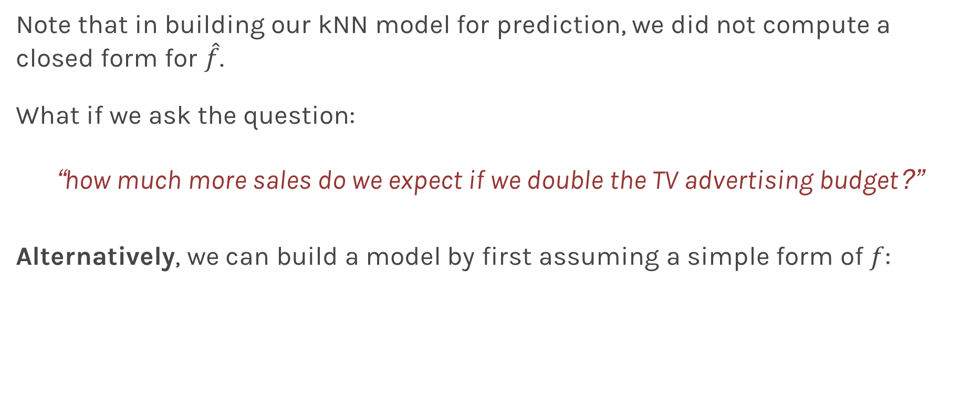
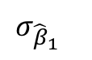
Summary from last lecture
We evaluate the importance of predictors using hypothesis testing, using the t-statistics and p-values.
$$μ_{{\hat{β}}_{1}}−0$$
2
$$σ_{{\hat{β}}_{1}}$$

Slide 8
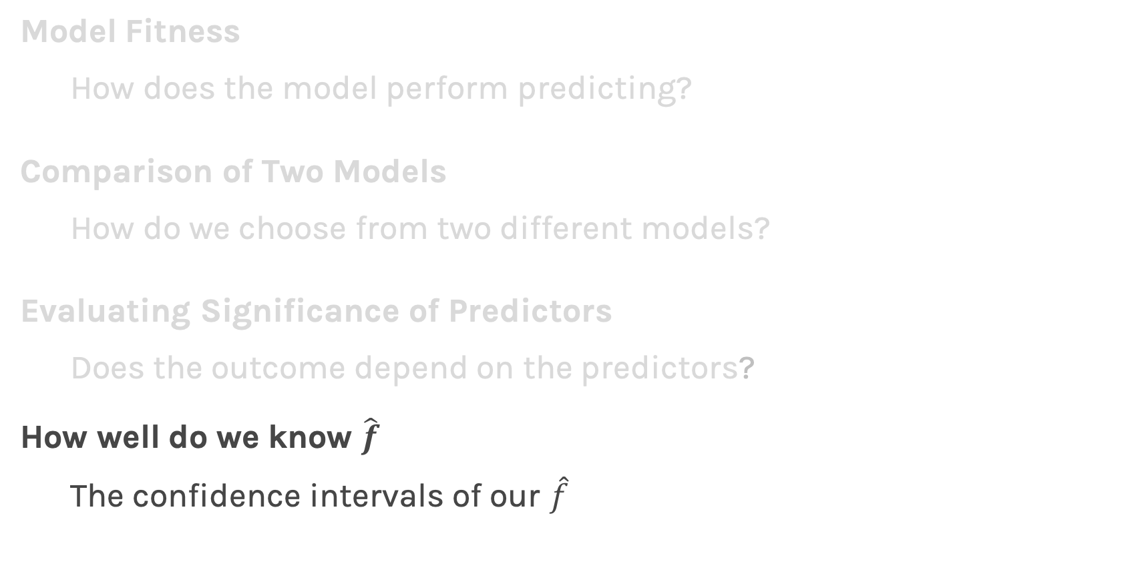
Summary from last lecture
Model Fitness
How does the model perform predicting?
Comparison of Two Models
How do we choose from two different models?
Evaluating Significance of Predictors
Does the outcome depend on the predictors?
How well do we know $\hat{f}$
The confidence intervals of our $\hat{f}$
This lecture

Slide 9
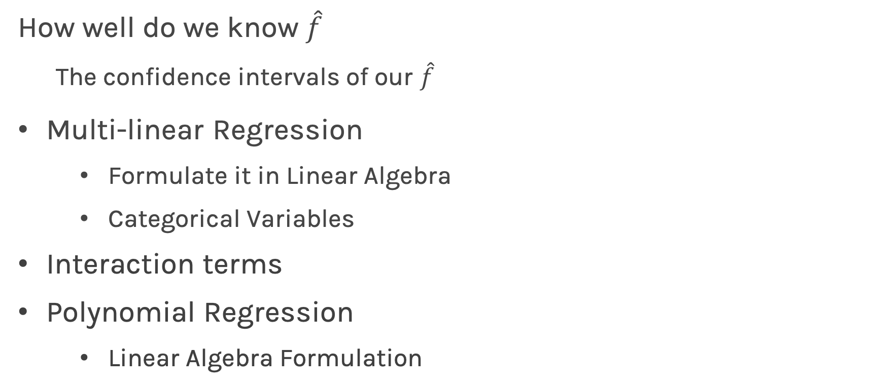
Summary
How well do we know $\hat{f}$
The confidence intervals of our $\hat{f}$
Multi-linear Regression
Formulate it in Linear Algebra
Categorical Variables
Interaction terms
Polynomial Regression
Linear Algebra Formulation

Slide 10
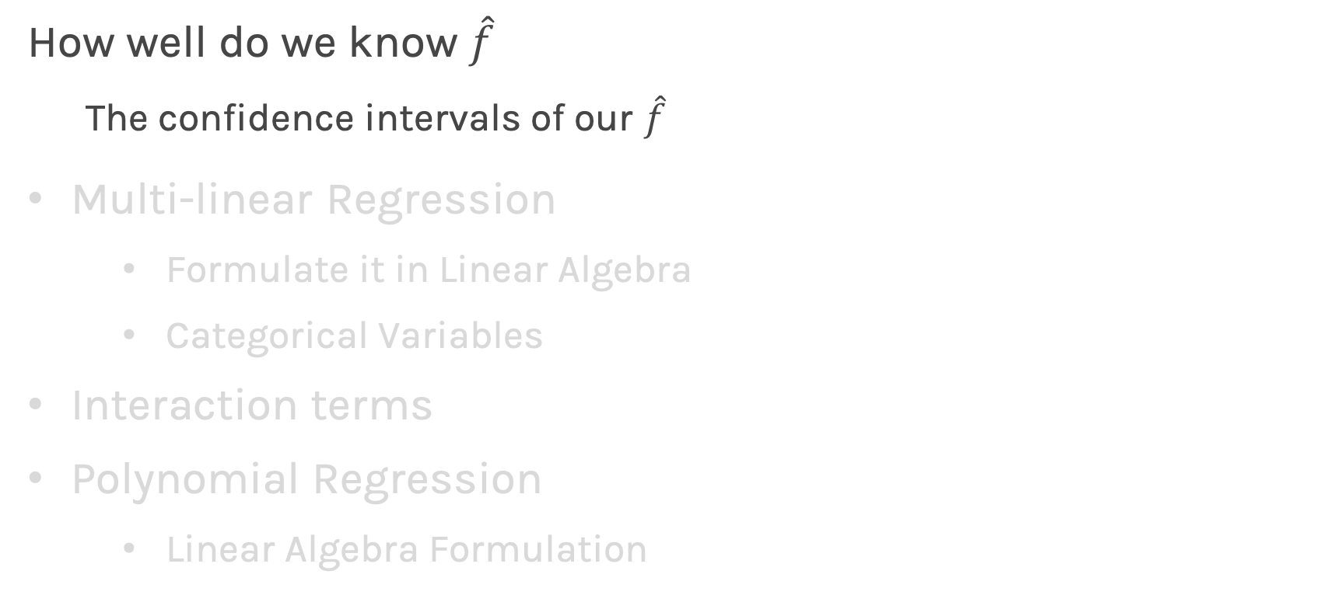
Summary
How well do we know $\hat{f}$
The confidence intervals of our $\hat{f}$
Multi-linear Regression
Formulate it in Linear Algebra
Categorical Variables
Interaction terms
Polynomial Regression
Linear Algebra Formulation

Slide 11
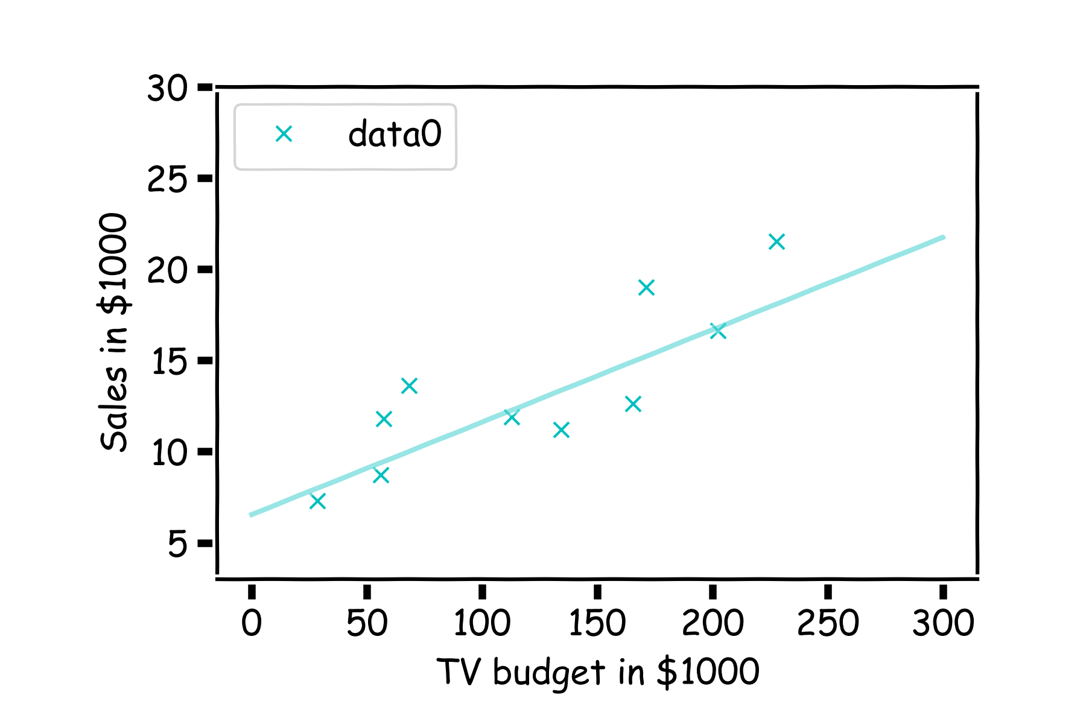
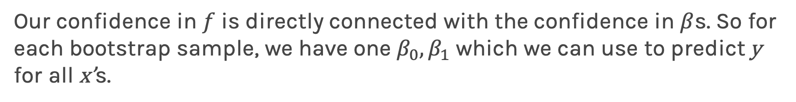
How well do we know $\hat{f}$?
Our confidence in $f$ is directly connected with the confidence in $β$s. So for each bootstrap sample, we have one $β_{0},β_{1}$ which we can use to predict y for all x’s.

Slide 12
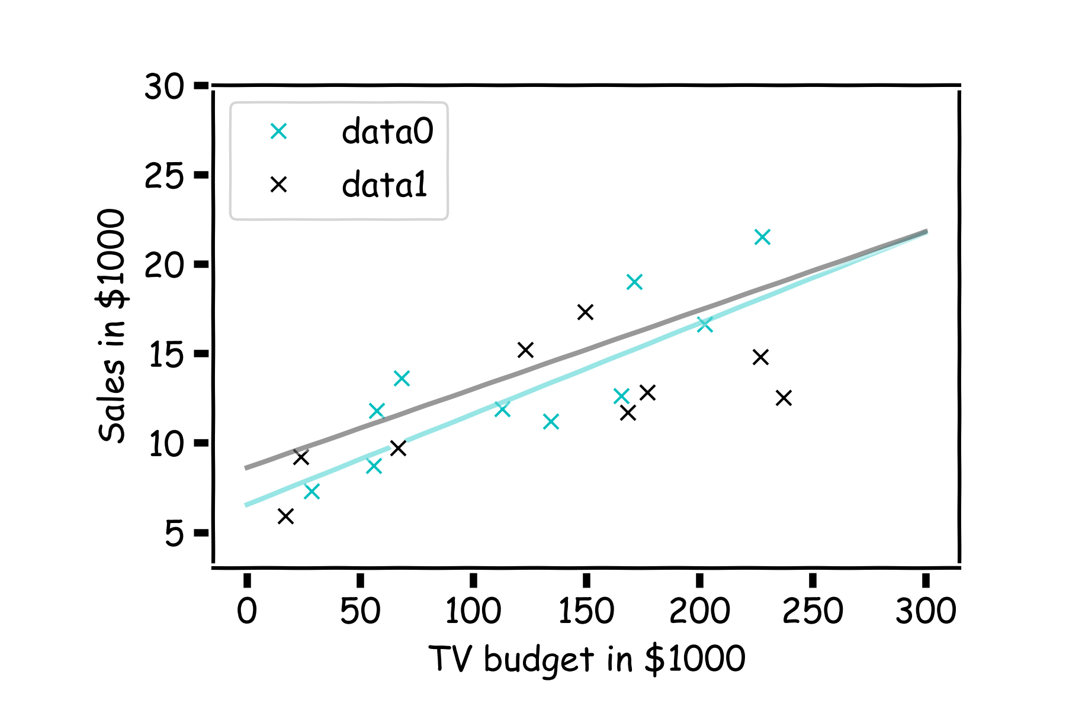
How well do we know $\hat{f}$?
Here we show two difference set of models given the fitted coefficients.

Slide 13
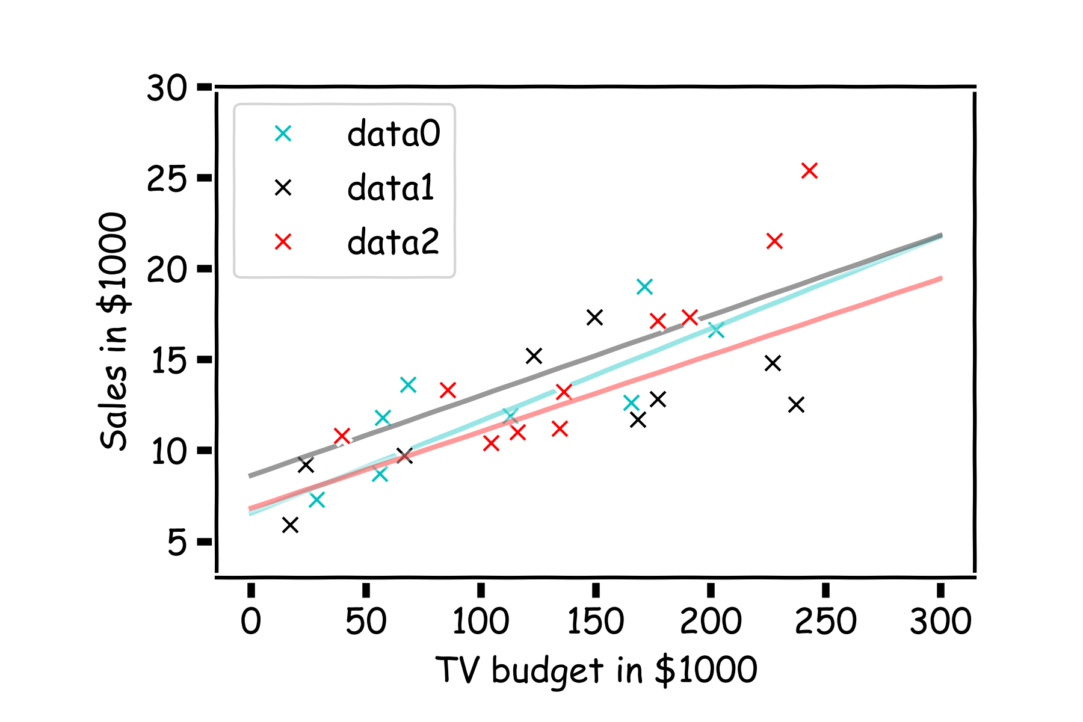
How well do we know $\hat{f}$?
There is one such regression line for every bootstrapped sample.

Slide 14
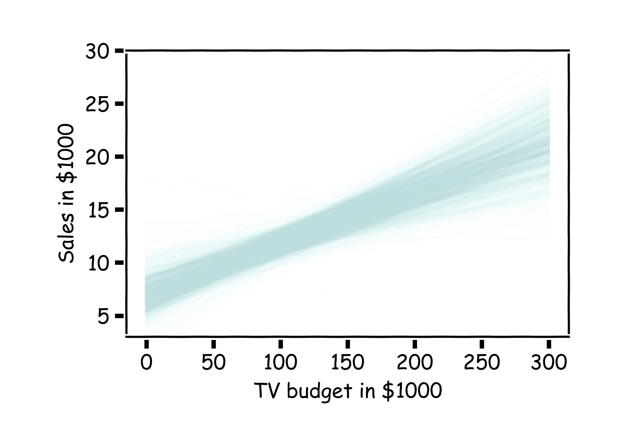
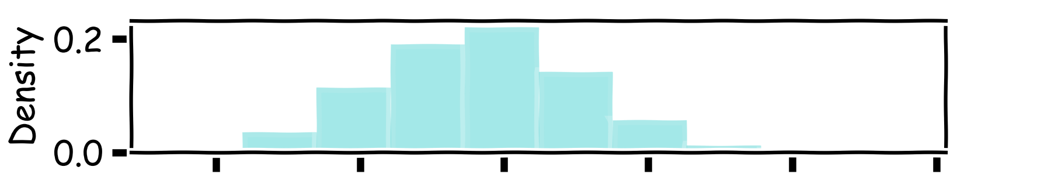
How well do we know $\hat{f}$?
Below we show all regression lines for a thousand of such bootstrapped samples.
For a given $x$, we examine the distribution of $\hat{f}$, and determine the mean and standard deviation.

Slide 15
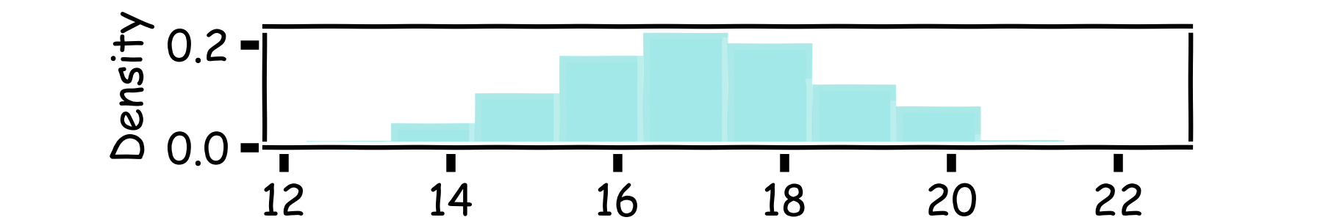
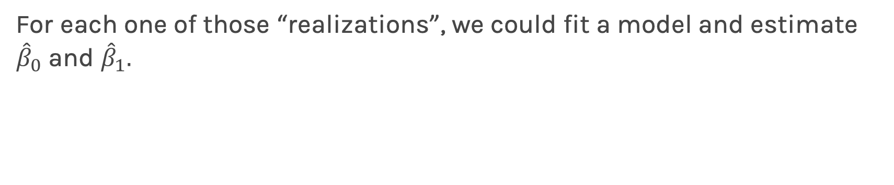
How well do we know $\hat{f}$?
Below we show all regression lines for a thousand of such sub-samples.
For a given $x$, we examine the distribution of $\hat{f}$, and determine the mean and standard deviation.

Slide 16
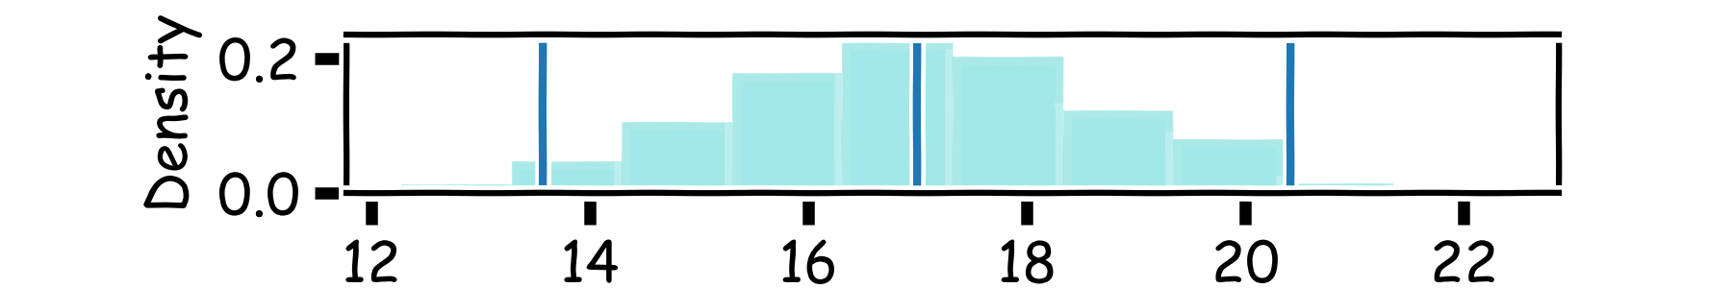
How well do we know $\hat{f}$?
Below we show all regression lines for a thousand of such sub-samples.
For a given $x$, we examine the distribution of $\hat{f}$, and determine the mean and standard deviation.

Slide 17
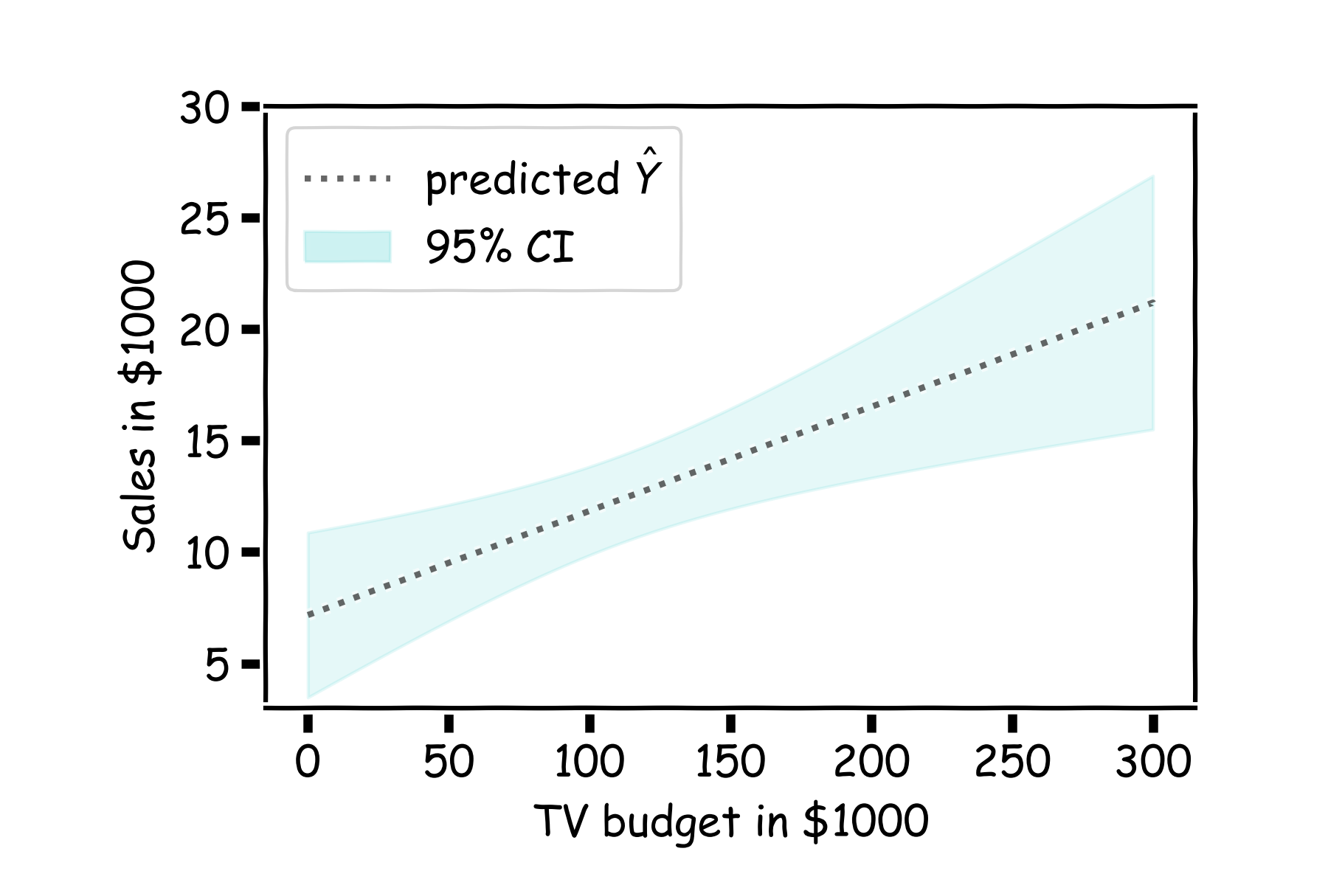
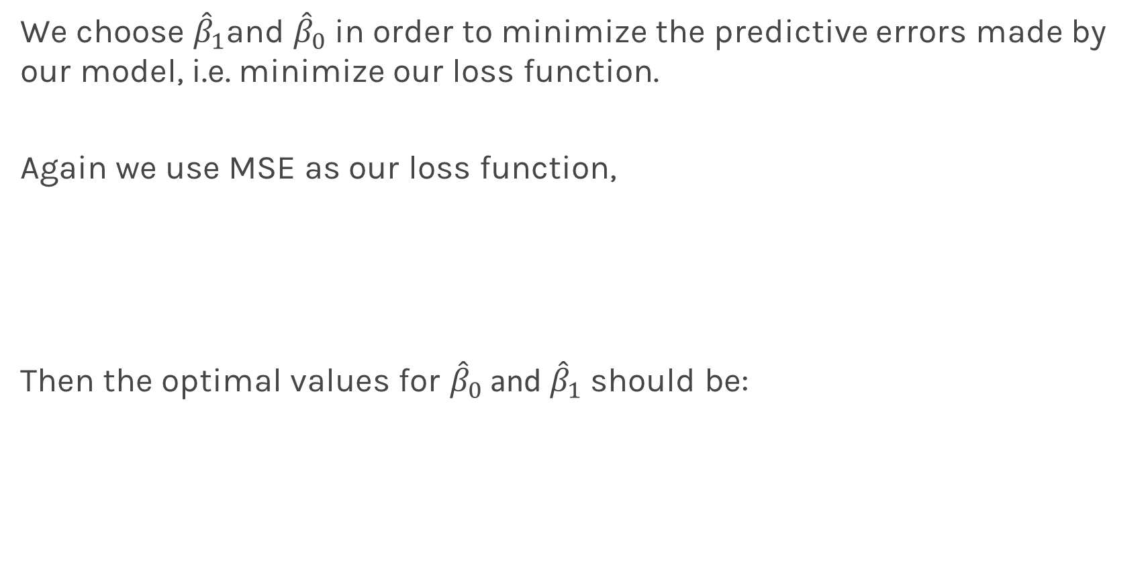
How well do we know $\hat{f}$?
For every $x$, we calculate the mean of the models, $\hat{f}$ (shown with dotted line) and the 95% CI of those models (shaded area).
Estimated $\hat{f}$

Slide 18
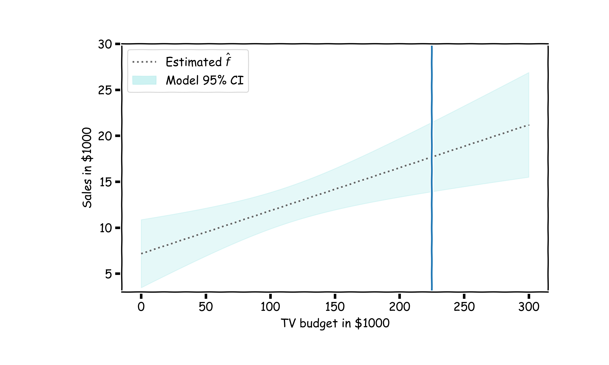
Confidence in predicting $\hat{y}$

Slide 19


Confidence in predicting $\hat{y}$
for a given x, we have a distribution of models $f\left(x\right)$
for each of these $f\left(x\right),$the prediction for $y\sim N(f, σ_{ε})$

Slide 20
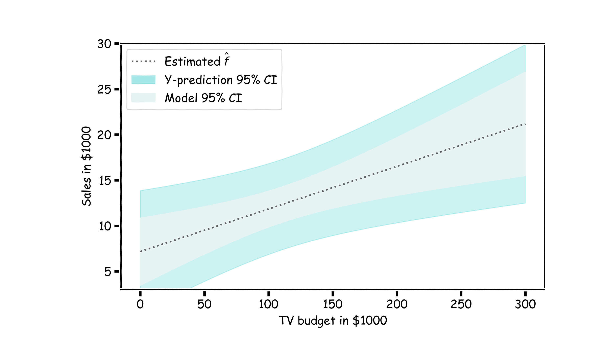
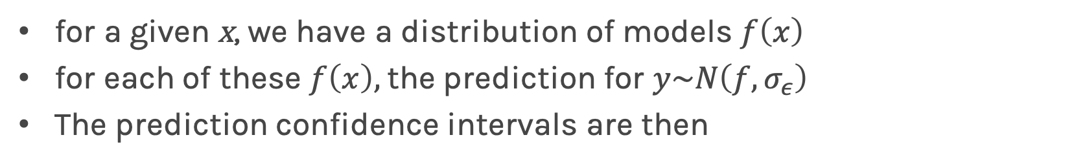
Confidence in predicting $\hat{y}$
for a given x, we have a distribution of models $f\left(x\right)$
for each of these $f\left(x\right),$the prediction for $y\sim N\left(f, σ_{ε}\right)$
The prediction confidence intervals are then

Slide 21
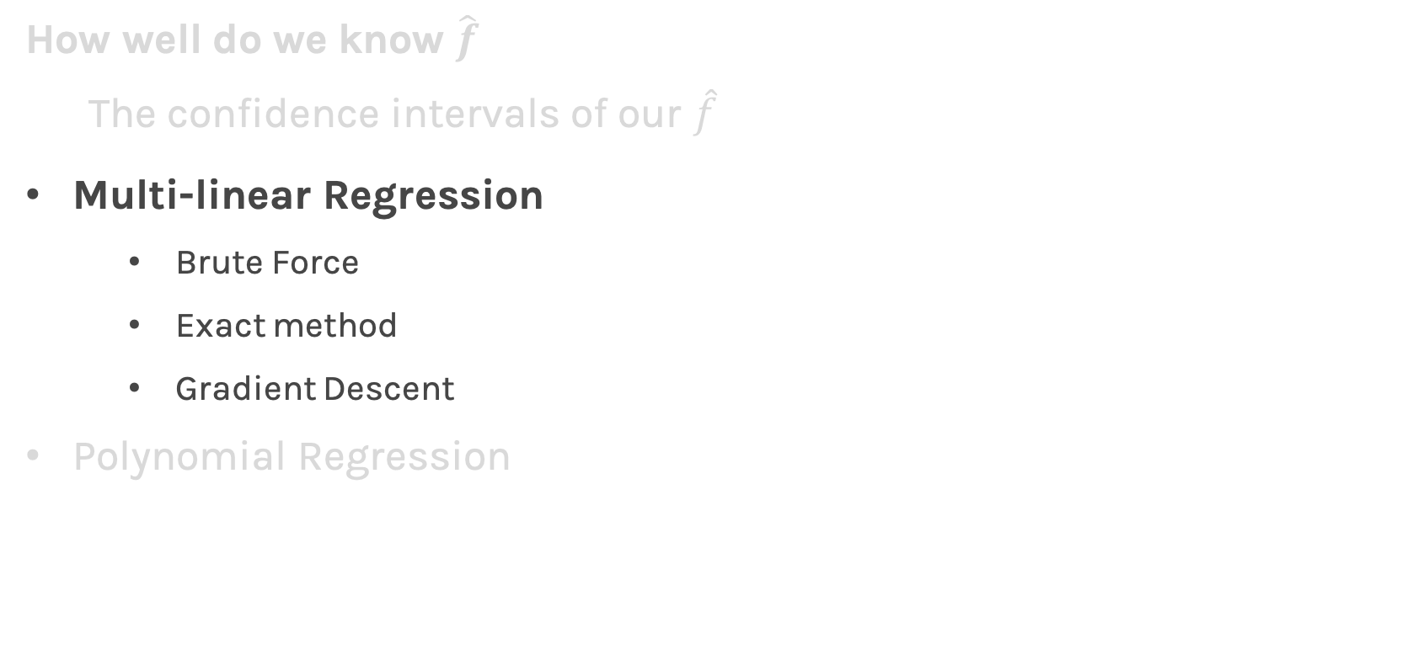
Lecture Outline
How well do we know $\hat{f}$
The confidence intervals of our $\hat{f}$
Multi-linear Regression
Brute Force
Exact method
Gradient Descent
Polynomial Regression

Slide 22
Multiple Linear Regression
If you have to guess someone's height, would you rather be told
Their weight, only
Their weight and gender
Their weight, gender, and income
Their weight, gender, income, and favorite number
Of course, you'd always want as much data about a person as possible. Even though height and favorite number may not be strongly related, at worst you could just ignore the information on favorite number. We want our models to be able to take in lots of data as they make their predictions.

Slide 23
Response vs. Predictor Variables
X
predictors
features
covariates
Y
outcome
response variable
dependent variable
TV | radio | newspaper | sales
230.1 | 37.8 | 69.2 | 22.1
44.5 | 39.3 | 45.1 | 10.4
17.2 | 45.9 | 69.3 | 9.3
151.5 | 41.3 | 58.5 | 18.5
180.8 | 10.8 | 58.4 | 12.9
n observations
p predictors

Slide 24
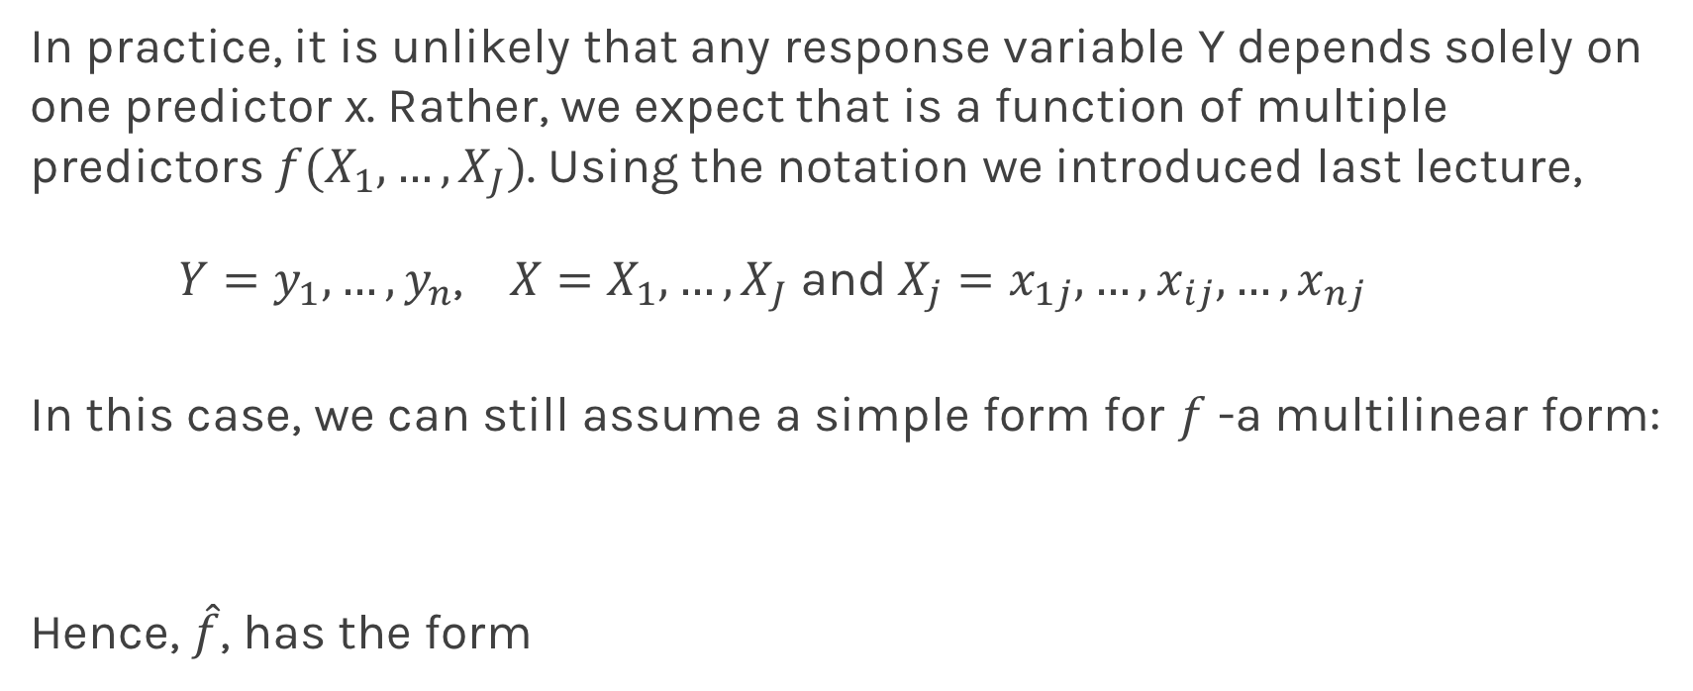
Multilinear Models
In practice, it is unlikely that any response variable Y depends solely on one predictor x. Rather, we expect that is a function of multiple predictors $f(X_{1},…,X_{J})$. Using the notation we introduced last lecture,
$Y=y_{1},…,y_{n}$, $X=X_{1},…,X_{J}$and$X_{j}=x_{1j},…,x_{ij},…,x_{nj}$
In this case, we can still assume a simple form for $f$-a multilinear form:
Hence, $\hat{f}$, has the form

Slide 25
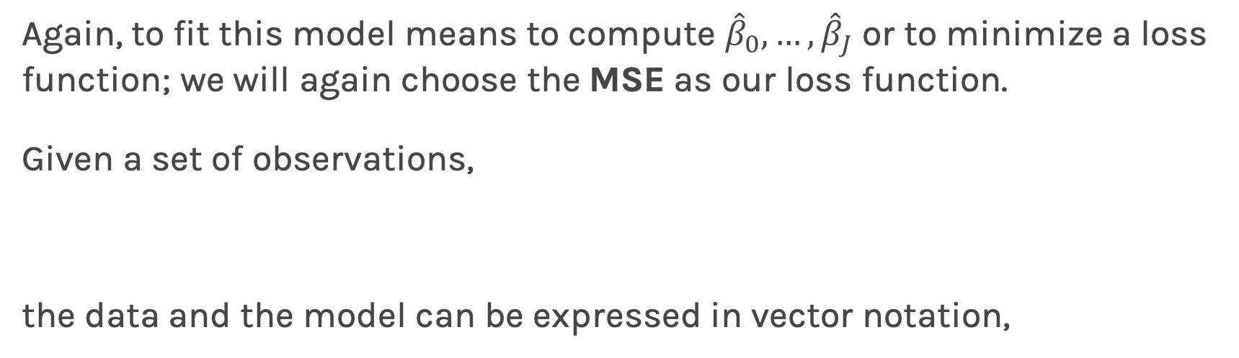
Multiple Linear Regression
Again, to fit this model means to compute ${\hat{β}}_{0},…,{\hat{β}}_{J}$ or to minimize a loss function; we will again choose the MSE as our loss function.
Given a set of observations,
the data and the model can be expressed in vector notation,
Notes:
We need a figure here

Slide 26

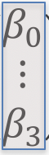
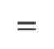

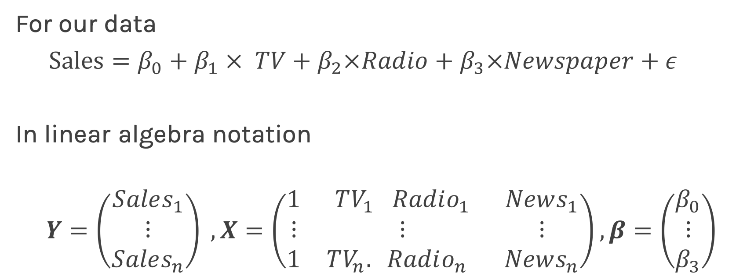
Multilinear Model, example
For our data
$Sales=β_{0}+β_{1} × TV+β_{2}×Radio+β_{3}×Newspaper+ε$
In linear algebra notation
$$Y=\left(\begin{matrix}Sales_{1} \\ ⋮ \\ Sales_{n}\end{matrix}\right) , X=\left(\begin{matrix}1 & TV_{1} Radio_{1} & News_{1} \\ ⋮ & ⋮ & ⋮ \\ 1 & TV_{n}. Radio_{n} & News_{n}\end{matrix}\right), β=\left(\begin{matrix}β_{0} \\ ⋮ \\ β_{3}\end{matrix}\right)$$
$$=$$
$$×$$

Slide 27
Multiple Linear Regression
The model takes a simple algebraic form:
Thus, the MSE can be expressed in vector notation as
Minimizing the MSE using vector calculus yields,
Notes:
We need a figure here

Slide 28
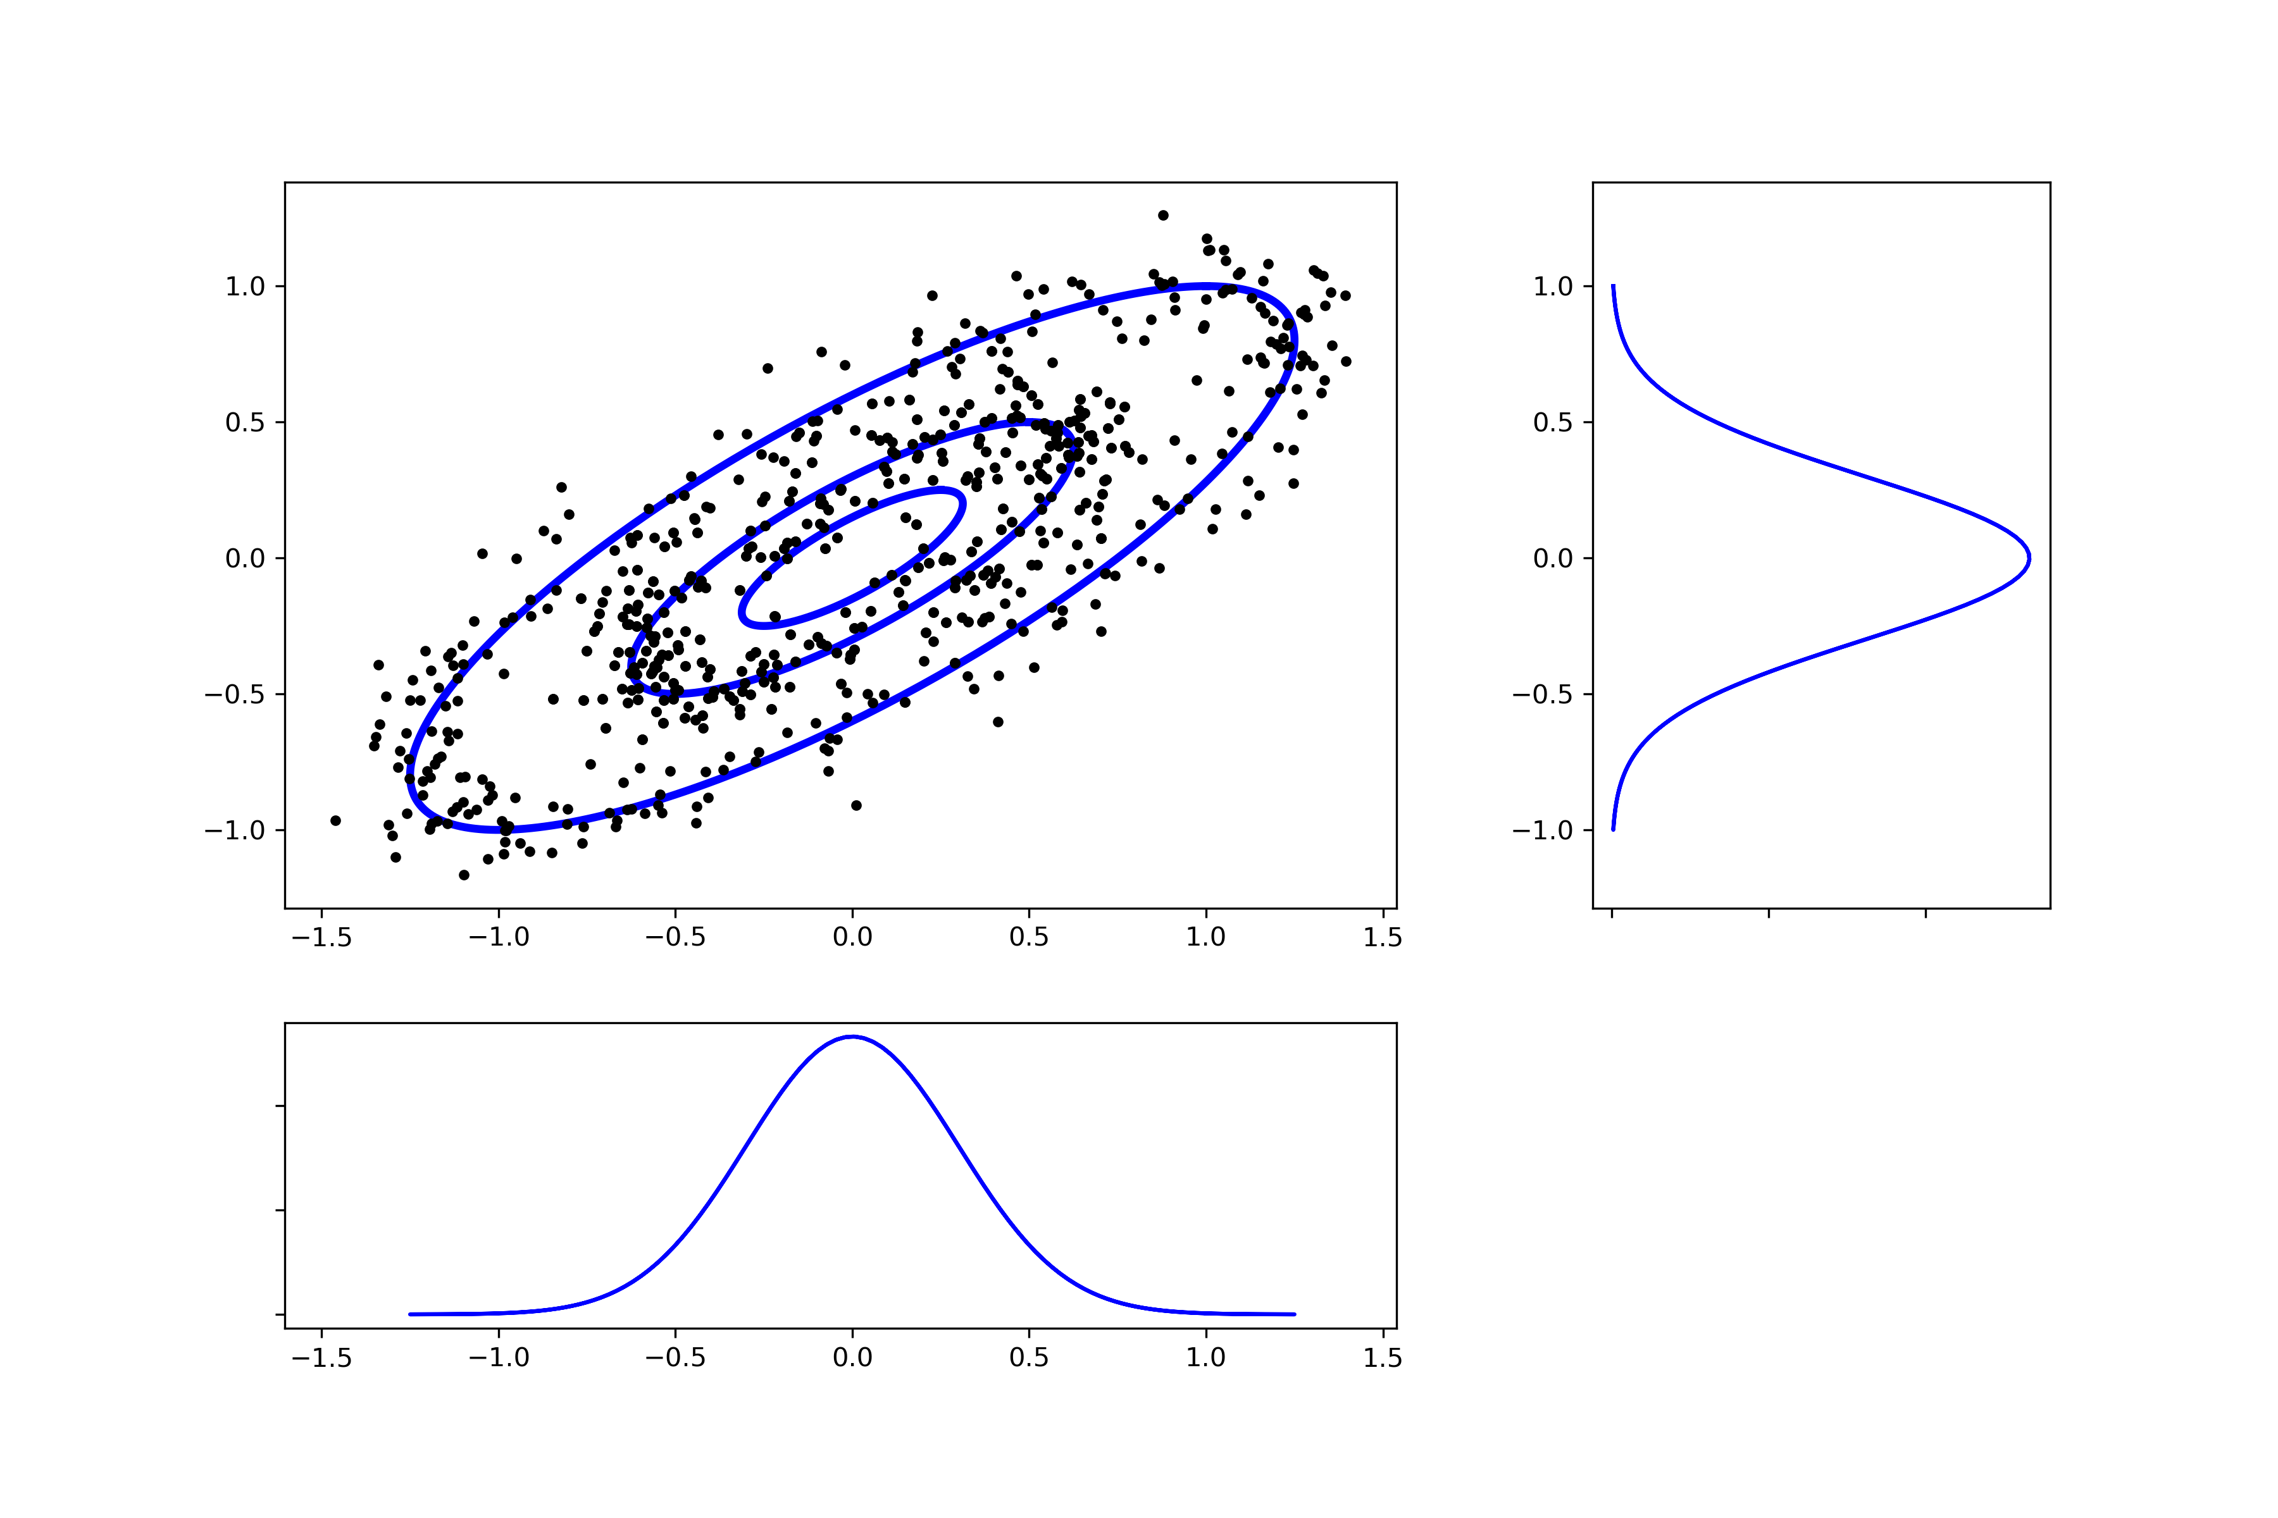
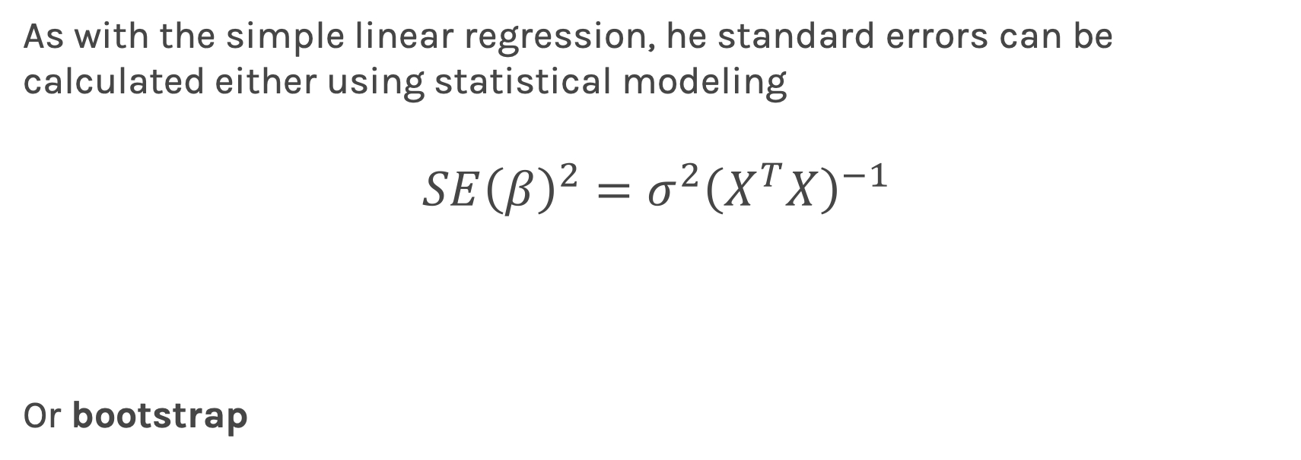
Standard Errors for Multiple Linear Regression
As with the simple linear regression, he standard errors can be calculated either using statistical modeling
$$SE{\left(β\right)}^{2}=σ^{2}{\left(X^{T}X\right)}^{−1}$$
Or bootstrap
Notes:
We need a figure here

Slide 29
Collinearity
Collinearity refers to the case in which two or more predictors are correlated (related).
We will re-visit collinearity in the next lecture when we address overfitting, but for now we want to examine how does collinearity affects our confidence on the coefficients and consequently on the importance of those coefficients.
Notes:
We need a figure here

Slide 30
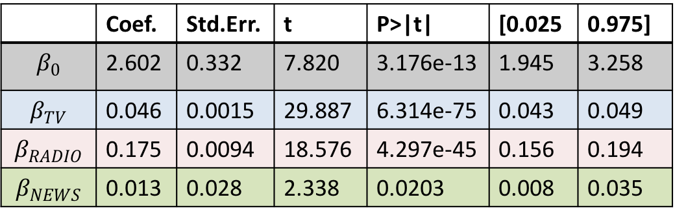
Collinearity
Three individual models
One model
TV
Coef. | Std.Err. | t | P>|t| | [0.025 | 0.975]
6.679 | 0.478 | 13.957 | 2.804e-31 | 5.735 | 7.622
0.048 | 0.0027 | 17.303 | 1.802e-41 | 0.042 | 0.053
RADIO
 | Coef. | Std.Err. | t | P>|t| | [0.025 | 0.975]
$$β_{0}$$ | 2.602 | 0.332 | 7.820 | 3.176e-13 | 1.945 | 3.258
$$β_{TV}$$ | 0.046 | 0.0015 | 29.887 | 6.314e-75 | 0.043 | 0.049
$$β_{RADIO}$$ | 0.175 | 0.0094 | 18.576 | 4.297e-45 | 0.156 | 0.194
$$β_{NEWS}$$ | 0.013 | 0.028 | 2.338 | 0.0203 | 0.008 | 0.035
Coef. | Std.Err. | t | P>|t| | [0.025 | 0.975]
9.567 | 0.553 | 17.279 | 2.133e-41 | 8.475 | 10.659
0.195 | 0.020 | 9.429 | 1.134e-17 | 0.154 | 0.236
NEWS
Coef. | Std.Err. | t | P>|t| | [0.025 | 0.975]
11.55 | 0.576 | 20.036 | 1.628e-49 | 10.414 | 12.688
0.074 | 0.014 | 5.134 | 6.734e-07 | 0.0456 | 0.102

Slide 31
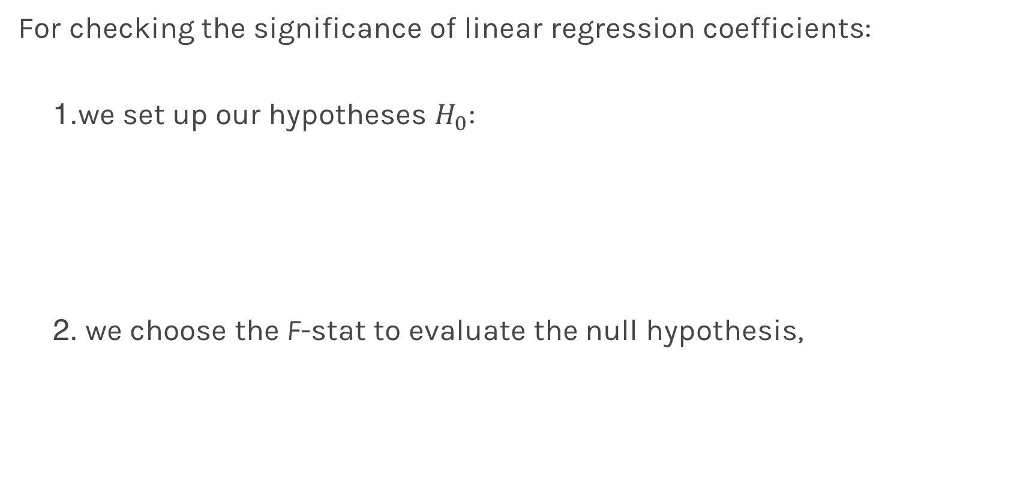
Finding Significant Predictors: Hypothesis Testing
For checking the significance of linear regression coefficients:
we set up our hypotheses $H_{0}$:
we choose the F-stat to evaluate the null hypothesis,

Slide 32
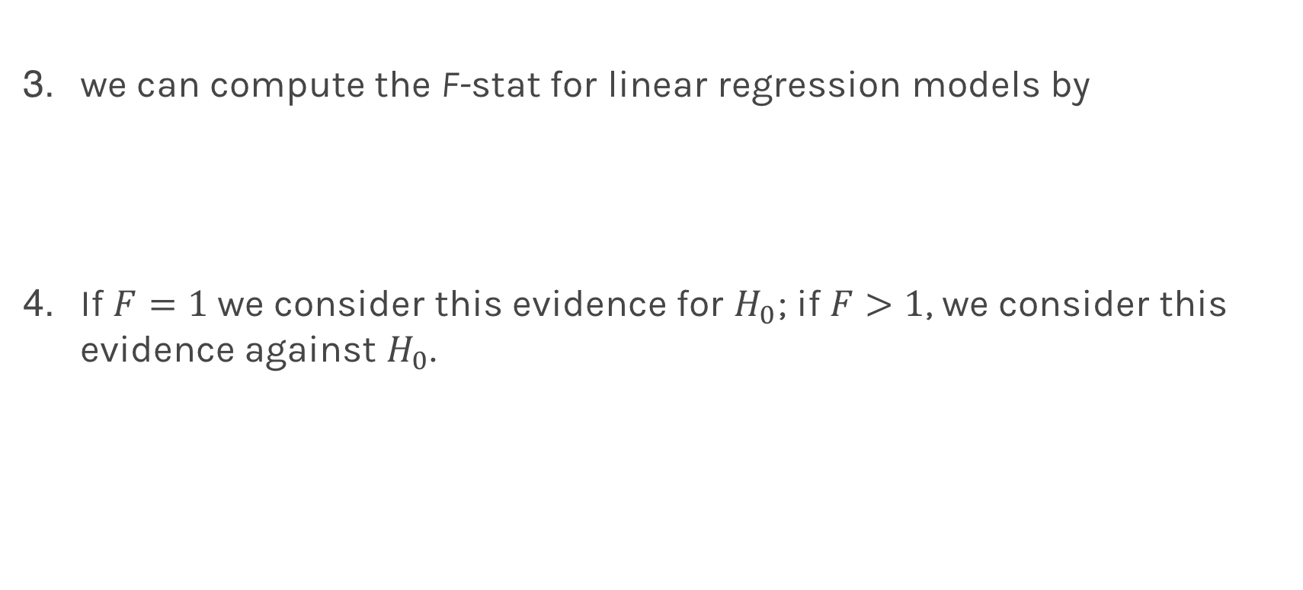
Finding Significant Predictors: Hypothesis Testing
we can compute the F-stat for linear regression models by
If $F=1$ we consider this evidence for $H_{0}$; if $F>1$, we consider this evidence against $H_{0}$.
2
2

Slide 33
Qualitative Predictors
So far, we have assumed that all variables are quantitative. But in practice, often some predictors are qualitative.
Example: The Credit data set contains information about balance, age, cards, education, income, limit , and rating for a number of potential customers.
Income | Limit | Rating | Cards | Age | Education | Gender | Student | Married | Ethnicity | Balance
14.890 | 3606 | 283 | 2 | 34 | 11 | Male | No | Yes | Caucasian | 333
106.02 | 6645 | 483 | 3 | 82 | 15 | Female | Yes | Yes | Asian | 903
104.59 | 7075 | 514 | 4 | 71 | 11 | Male | No | No | Asian | 580
148.92 | 9504 | 681 | 3 | 36 | 11 | Female | No | No | Asian | 964
55.882 | 4897 | 357 | 2 | 68 | 16 | Male | No | Yes | Caucasian | 331

Slide 34
Qualitative Predictors
If the predictor takes only two values, then we create an indicator or dummy variable that takes on two possible numerical values.
For example for the gender, we create a new variable:
We then use this variable as a predictor in the regression equation.

Slide 35

Qualitative Predictors
Question: What is interpretation of $β_{0}$ and $β_{1}$?

Slide 36
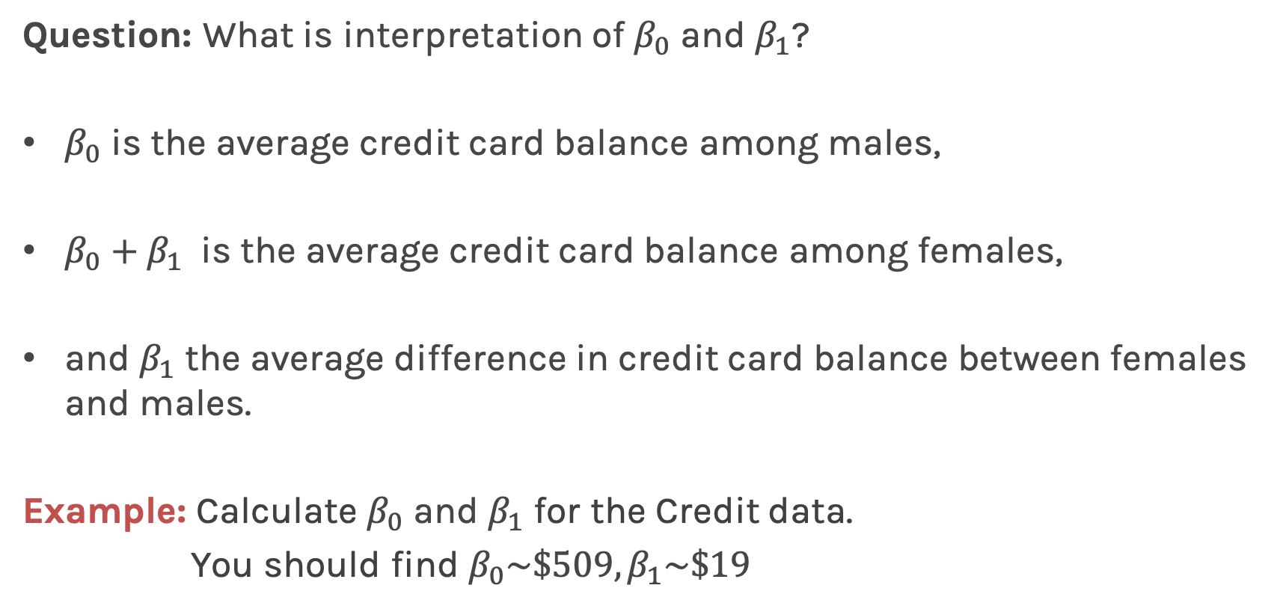
Qualitative Predictors
Question: What is interpretation of $β_{0}$ and $β_{1}$?
$β_{0}$ is the average credit card balance among males,
$β_{0}+β_{1}$ is the average credit card balance among females,
and $β_{1}$ the average difference in credit card balance between females and males.
Example: Calculate $β_{0}$ and $β_{1}$ for the Credit data.
You should find $β_{0}\sim \$509,β_{1}\sim \$19$

Slide 37
More than two levels: One hot encoding
Often, the qualitative predictor takes more than two values (e.g. ethnicity in the credit data).
In this situation, a single dummy variable cannot represent all possible values.
We create additional dummy variable as:

Slide 38
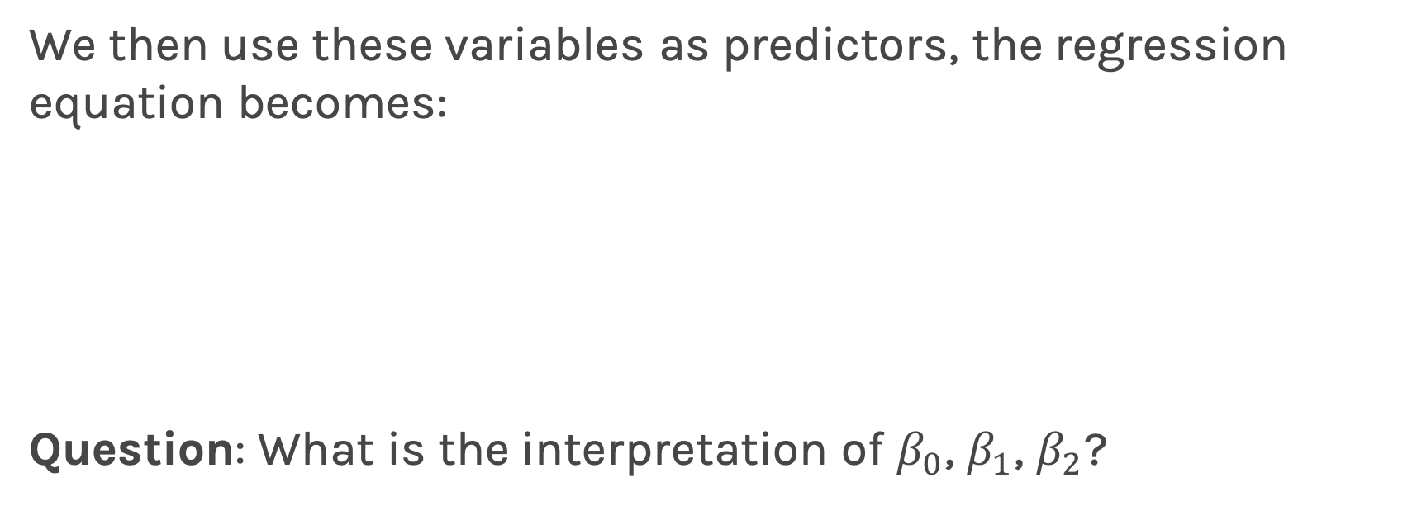
More than two levels: One hot encoding
We then use these variables as predictors, the regression equation becomes:
Question: What is the interpretation of $β_{0}$, $β_{1}$, $β_{2}$?
Notes:
[ADD interpretation and ONE HOT ENCODING]

Slide 39
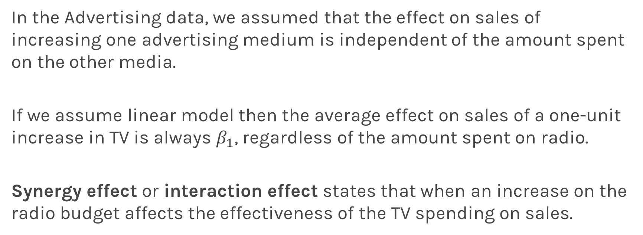
Beyond linearity
In the Advertising data, we assumed that the effect on sales of increasing one advertising medium is independent of the amount spent on the other media.
If we assume linear model then the average effect on sales of a one-unit increase in TV is always $β_{1}$, regardless of the amount spent on radio.
Synergy effect or interaction effect states that when an increase on the radio budget affects the effectiveness of the TV spending on sales.

Slide 40
Beyond linearity
We change
To

Slide 41
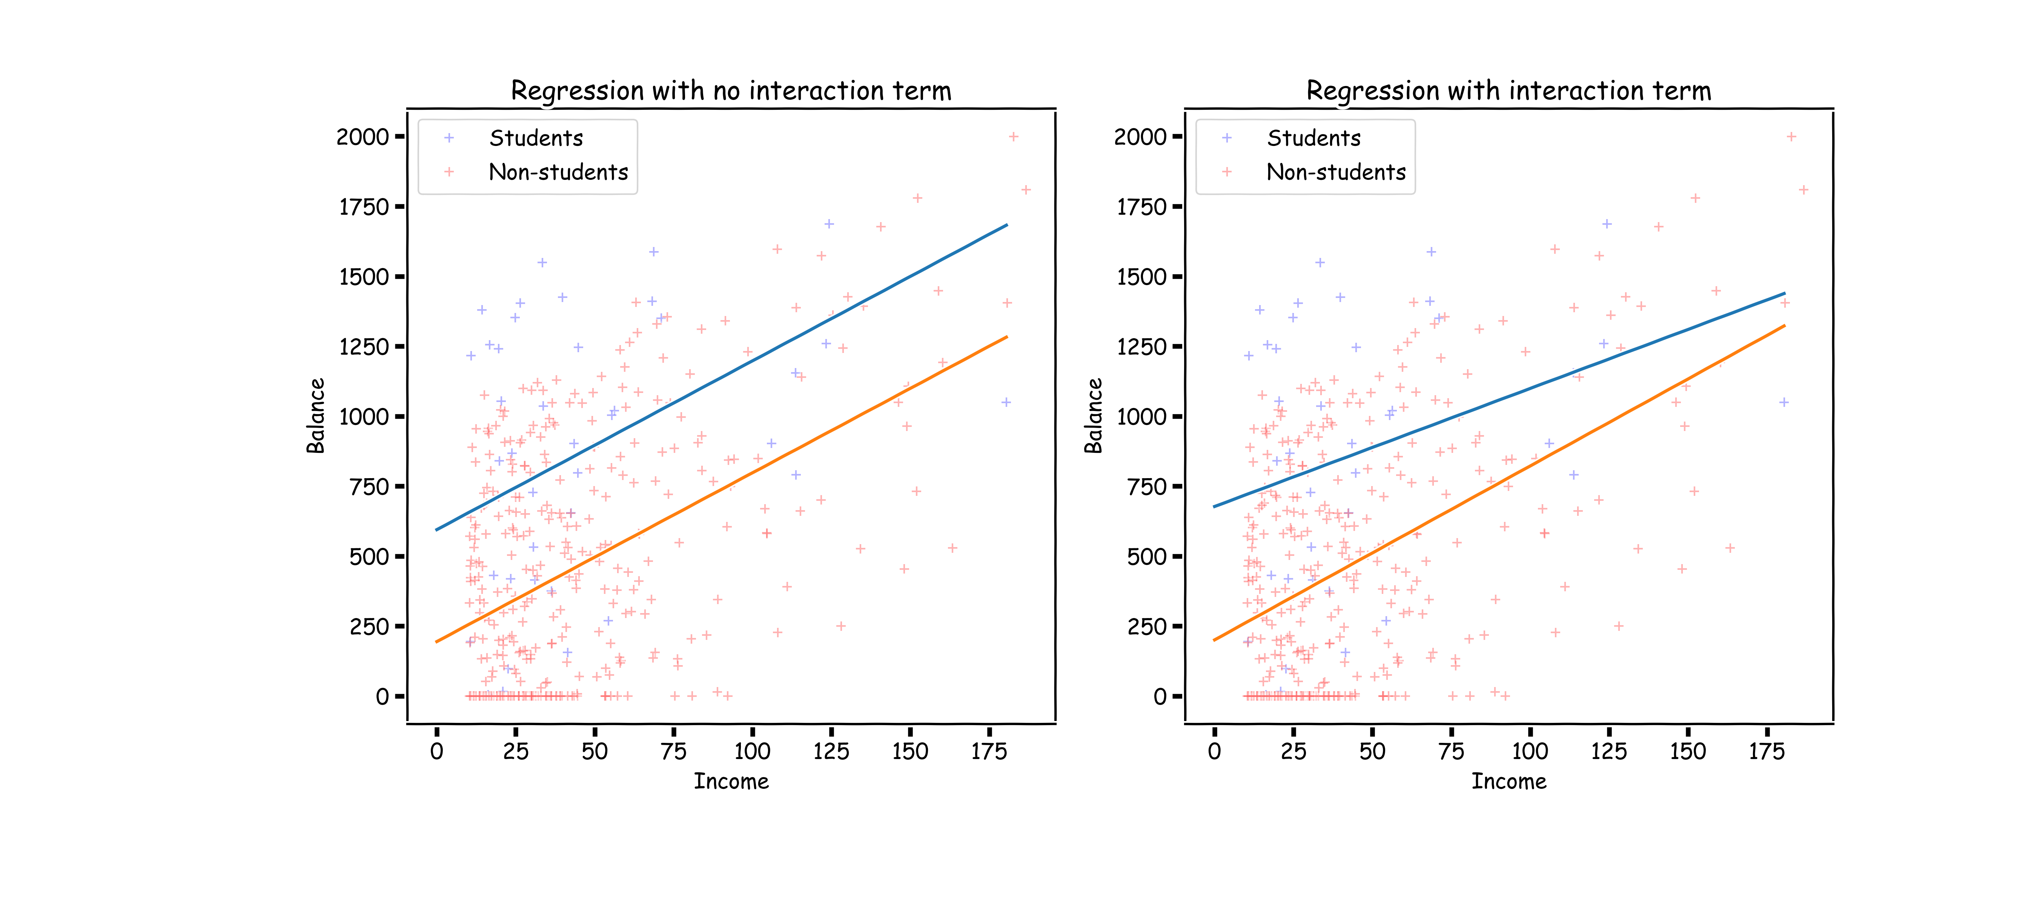
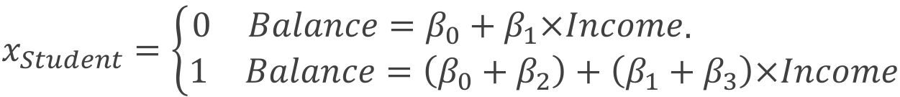
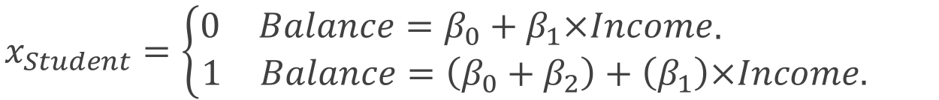
What does it mean?
$$x_{Student}=\left\{\begin{aligned}\begin{matrix}0 & Balance=β_{0}+β_{1}×Income\end{matrix}. \\ \begin{matrix}1 & Balance=\left(β_{0}+β_{2}\right)+\left(β_{1}\right)×Income. \end{matrix}\end{aligned}\right.$$
$$x_{Student}=\left\{\begin{aligned}\begin{matrix}0 & Balance=β_{0}+β_{1}×Income\end{matrix}. \\ \begin{matrix}1 & Balance=\left(β_{0}+β_{2}\right)+\left(β_{1}+β_{3}\right)×Income\end{matrix}\end{aligned}\right.$$

Slide 42
Predictors predictors predictors
We have a lot predictors!
Is it a problem?
Yes: Computational Cost
Yes: Overfitting
Wait there is more …

Slide 43


Slide 44
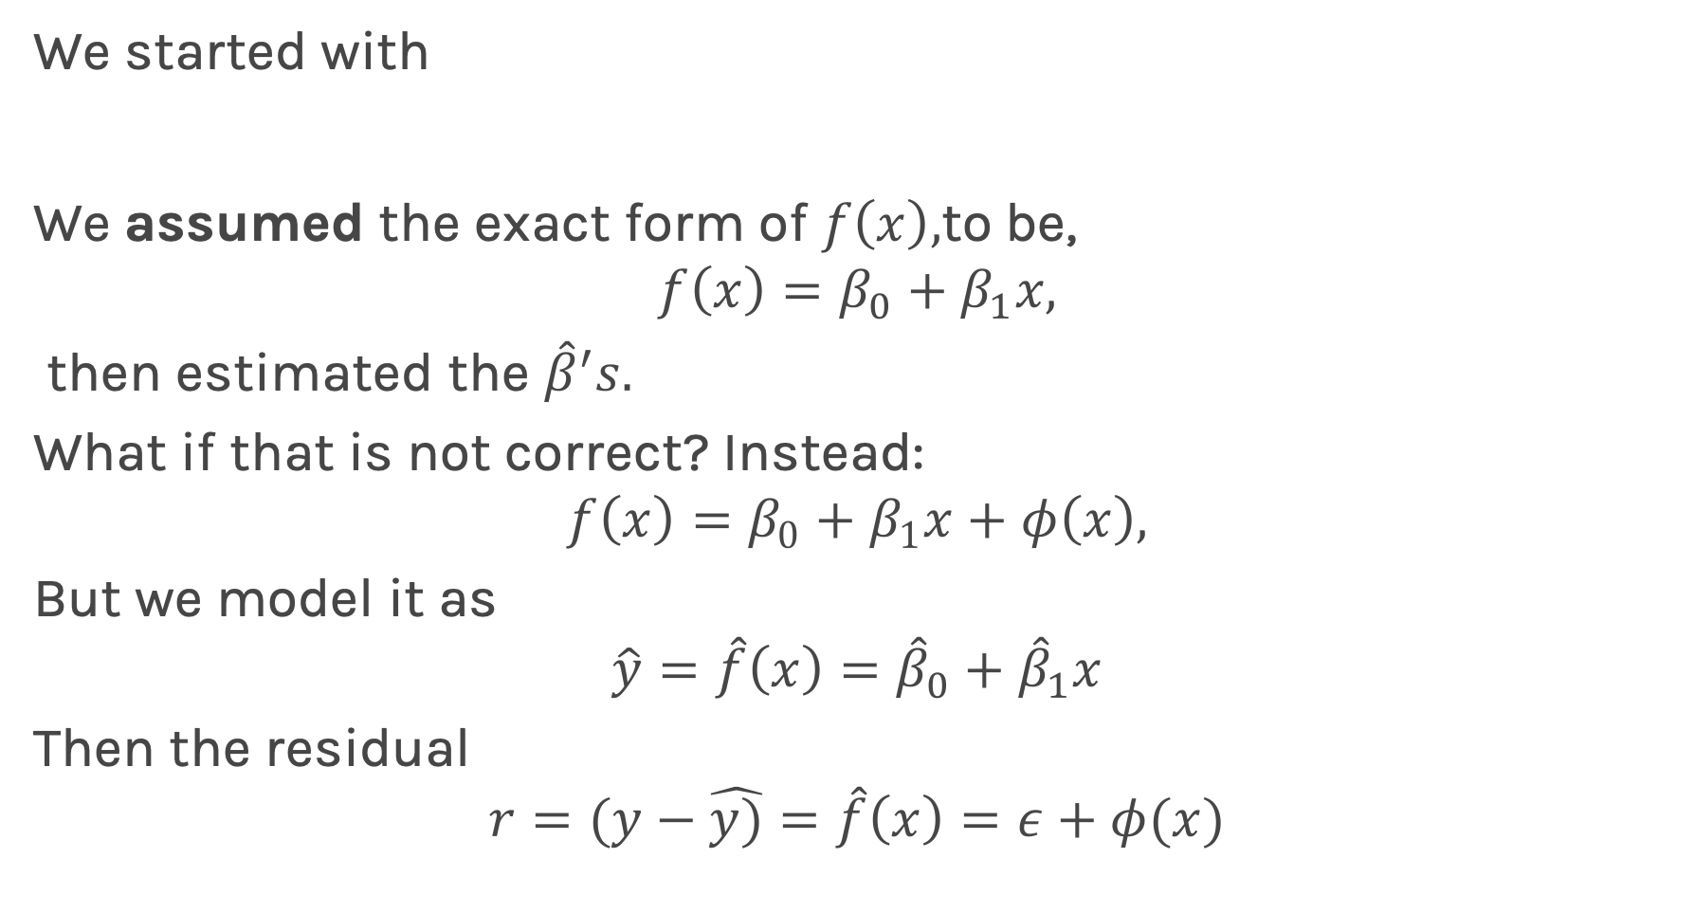
Residuals
We started with
We assumed the exact form of $f\left(x\right),$to be,
$$f\left(x\right)=β_{0}+β_{1}x,$$
then estimated the ${\hat{β}}^{′}s.$
What if that is not correct? Instead:
$$f\left(x\right)=β_{0}+β_{1}x+φ\left(x\right),$$
But we model it as
$$\hat{y}=\hat{f}\left(x\right)={\hat{β}}_{0}+{\hat{β}}_{1}x$$
Then the residual
$$r=(y−\hat{y)}=\hat{f}\left(x\right)=ε+φ(x)$$

Slide 45
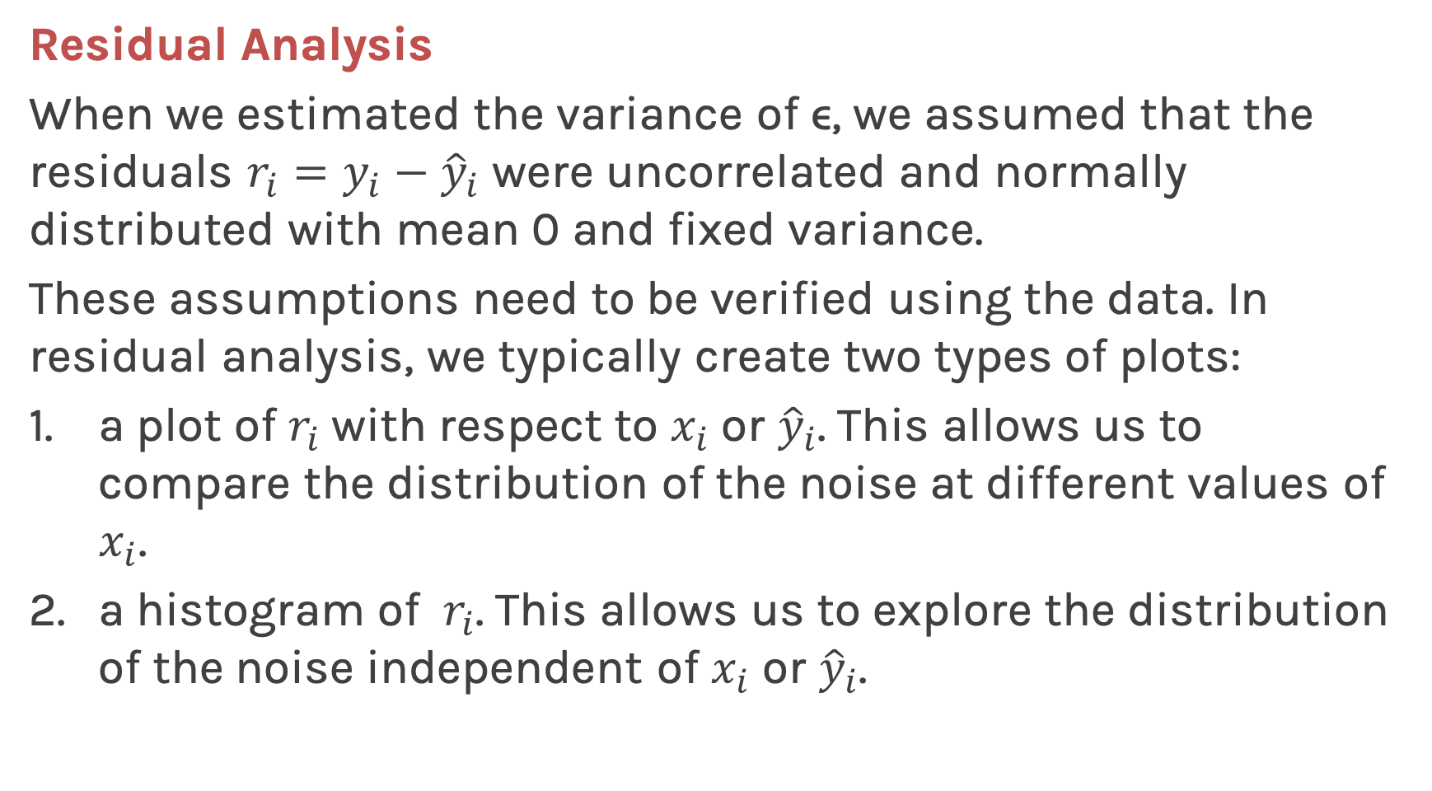
Residuals
Residual Analysis
When we estimated the variance of ϵ, we assumed that the residuals $r_{i}=y_{i}−{\hat{y}}_{i}$ were uncorrelated and normally distributed with mean 0 and fixed variance.
These assumptions need to be verified using the data. In residual analysis, we typically create two types of plots:
a plot of${ r}_{i}$with respect to $x_{i}$ or ${\hat{y}}_{i}$. This allows us to compare the distribution of the noise at different values of $x_{i}$.
a histogram of ${ r}_{i}$. This allows us to explore the distribution of the noise independent of $x_{i}$ or ${\hat{y}}_{i}$.

Slide 46
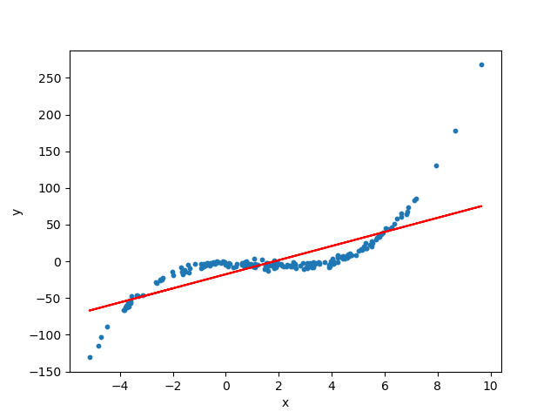
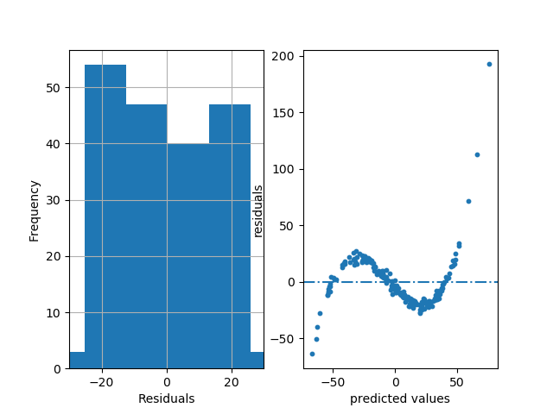
Residual Analysis

Slide 47
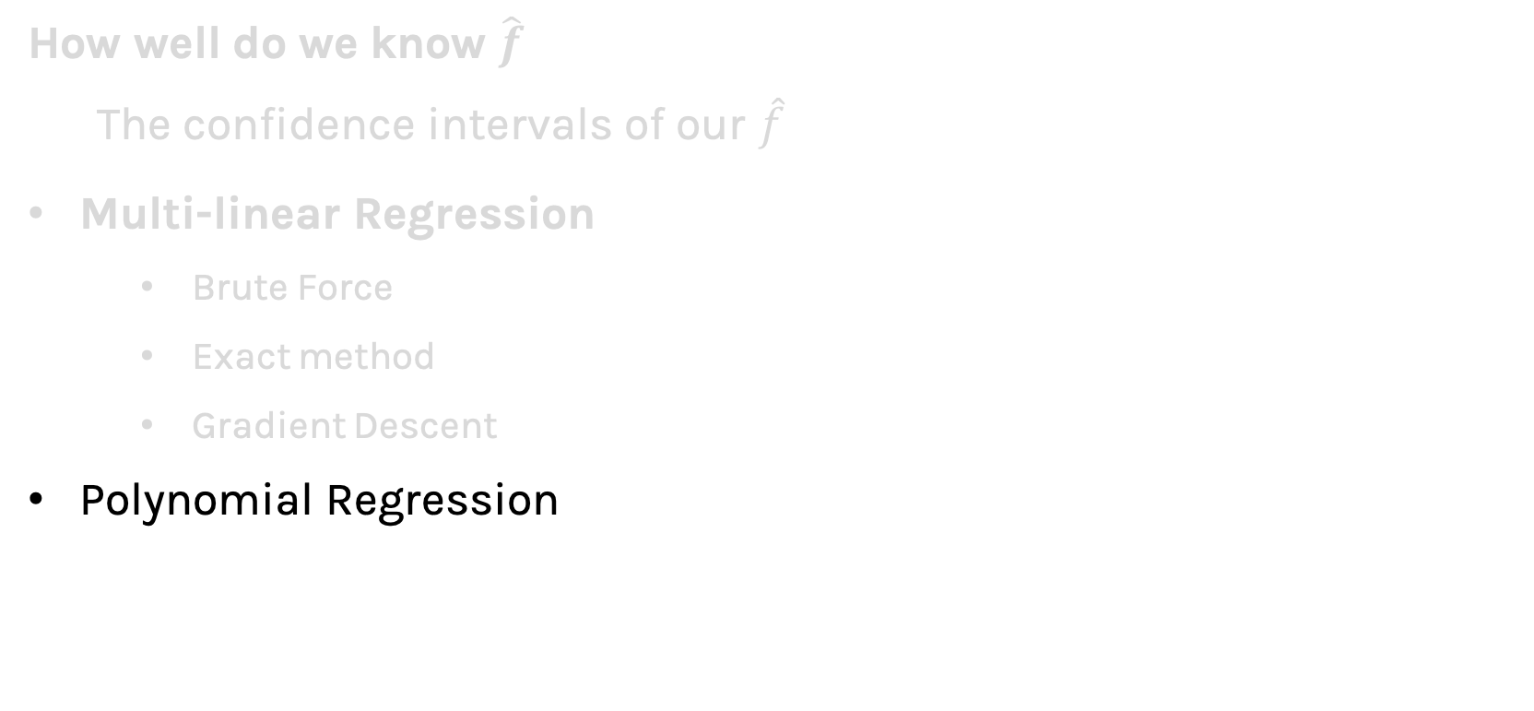
Lecture Outline
How well do we know $\hat{f}$
The confidence intervals of our $\hat{f}$
Multi-linear Regression
Brute Force
Exact method
Gradient Descent
Polynomial Regression

Slide 48
Polynomial Regression

Slide 49
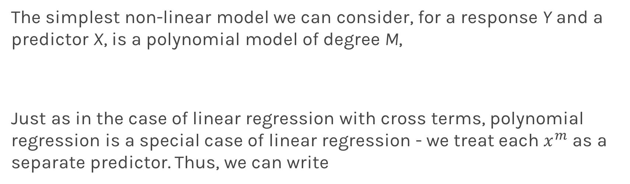
Polynomial Regression
The simplest non-linear model we can consider, for a response Y and a predictor X, is a polynomial model of degree M,
Just as in the case of linear regression with cross terms, polynomial regression is a special case of linear regression - we treat each $x^{m}$ as a separate predictor. Thus, we can write

Slide 50
Polynomial Regression
Again, minimizing the MSE using vector calculus yields,

Slide 51

Polynomial Regression (cont)

Slide 52

Polynomial Regression (cont)

Slide 53

Polynomial Regression (cont)

Slide 54

Polynomial Regression (cont)

Slide 55

Polynomial Regression (cont)

Slide 56

Polynomial Regression (cont)

Slide 57

Overfitting
In statistics, overfitting is "the production of an analysis that corresponds too closely or exactly to a particular set of data, and may therefore fail to fit additional data or predict future observations reliably”
More on this on Wednesday

Slide 58

Summary
How well do we know $\hat{f}$
The confidence intervals of our $\hat{f}$
Multi-linear Regression
Formulate it in Linear Algebra
Categorical Variables
Interaction terms
Polynomial Regression
Linear Algebra Formulation

Slide 59
Afternoon Exercises
Quiz - to be completed in the next 10 min:
Sway: Lecture 6: Multi and poly Regression
Programmatic – to be completed by lab time tomorrow:
Lessons: Lecture 6:

